Slide 1

HINDU FORUM EUROPE

Slide 2

HINDU FORUM OF EUROPE
The Hindu Forum of Europe was founded in 2006 in collaboration with an array of Hindu organisations across Europe.
The Forum works to cohesively share and promote the European values of interfaith, friendship and peaceful coexistence.
We Pledge to join hands and work together as the Hindu Forum of Europe.

Slide 3
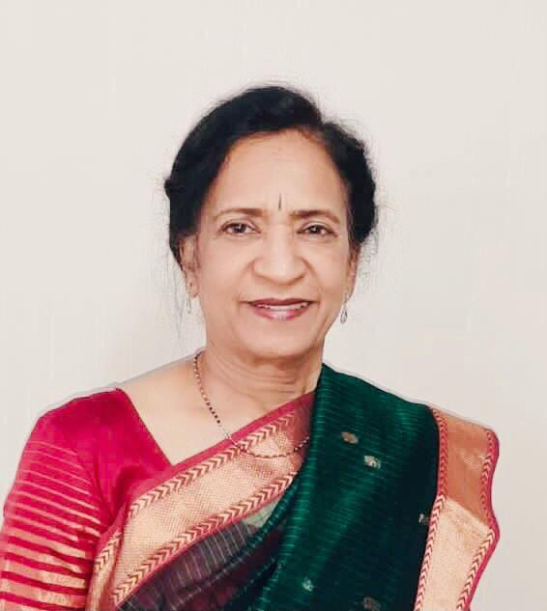
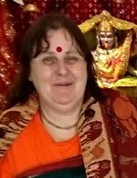
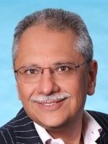
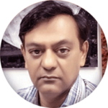
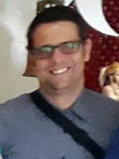
Board Members
Vice President
Marie Spennare
(Mandakini)
PRESIDENT
Dr. Lakshmi Vyas
Arun Jogani
Co-opted Member
Tresurer
Gianluca Triano
Kesh Morjaria
Executive Director

Slide 4
What we do
To support countries set up Hindu Umbrella organisations
Support Hindu Communities in Europe recognition by Govt.
Create awareness on the positive contributions of the Hindu
Communities in Europe
Get involved in different types of Interfaith Dialogue with all faith
and convictional communities in Europe
Help Hindu minorities that are being persecuted and/or
discriminated around the world by creating awareness in Europe
especially at the EU institutions
Combat, discrimination, hate crimes and speech
Monitor textbooks in Europe and how they portray Hinduism

Slide 5
Participate in Conferences and debates on relevant issues and presenting the Hindu perspective
Working with other NGOs that promote mutual respect, pluralism, respect for human rights
Help the Hindu Communities of Europe to integrate and become active participants and represent the interests and concerns of the Hindu Communities to the EU institutions.
To organise a high level Diwali event at the European Parliament every year to highlight the contributions of the Hindu Communities in Europe and of Hinduism in general.
To help organise Diwali Celebrations in Different major capitals throughout Europe
Working toward the recognition of Hinduism in all the 29 States of Europe

Slide 6
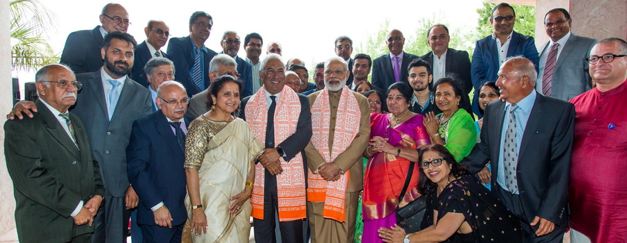

Slide 7
VISION FOR FUTURE
GETTING RELEGIOUS RECOGNITION FOR HINDUS IN ALL EUROPEAN COUNTRIES
MAKE MORE COUNTRIES INCLUSIVE LIKE POLAND, FRANCE, SLOVANIA, FINLAND
TO MAKE US VISIBLE CELEBRATE DIWALI IN SQUARES LIKE ‘DIL’ –TRAFALGAR SQUARE, PROMINADE OF GERMANY
CONTINUOUSLY LIAISE WITH COMMUNITIIES
ENCOURAGE & PROMOTE HINDU CANDIDATES TO JOIN POLITIS -FOR EU ELECTIONS AND REPRESENTATIONS.

Slide 8
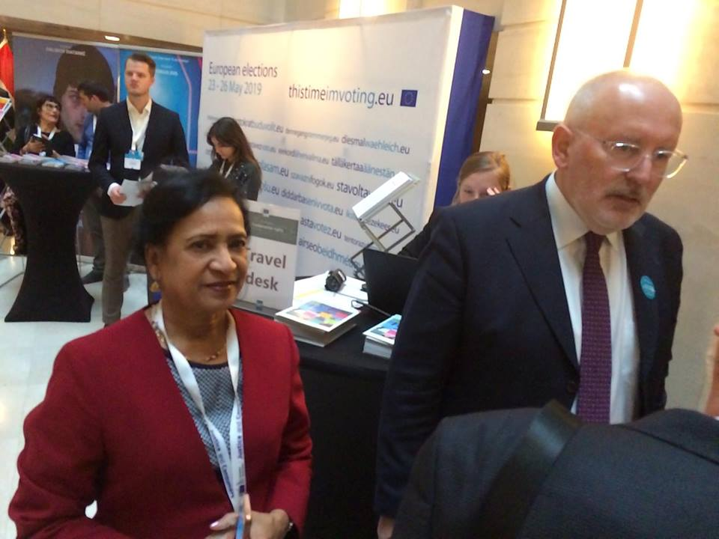
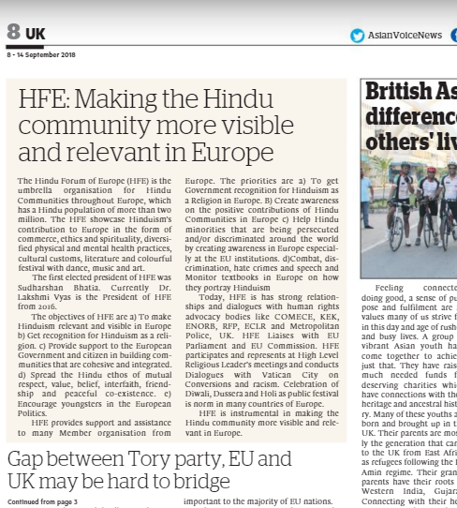

Slide 9
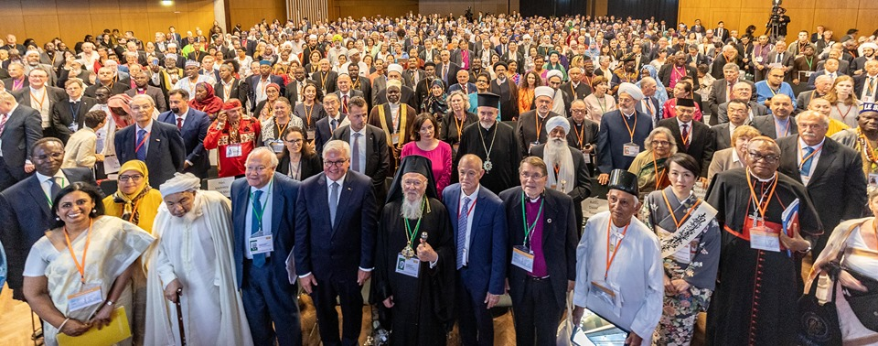

Slide 10
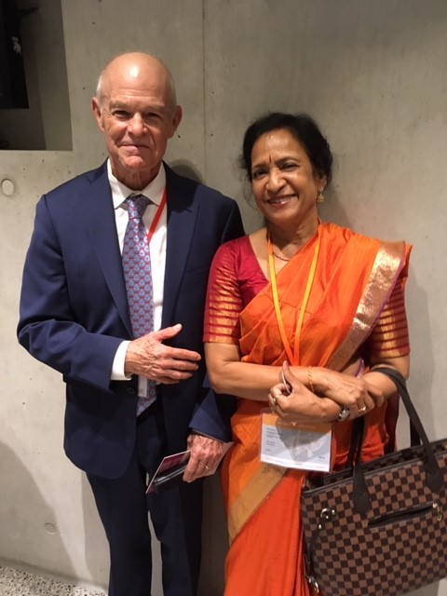
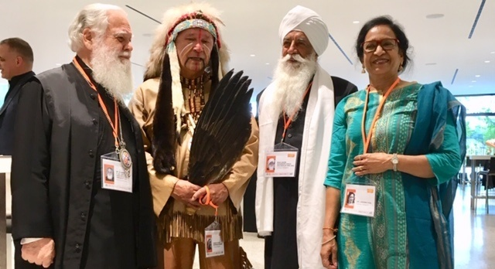
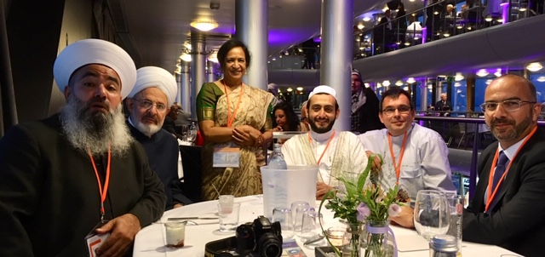

Slide 11
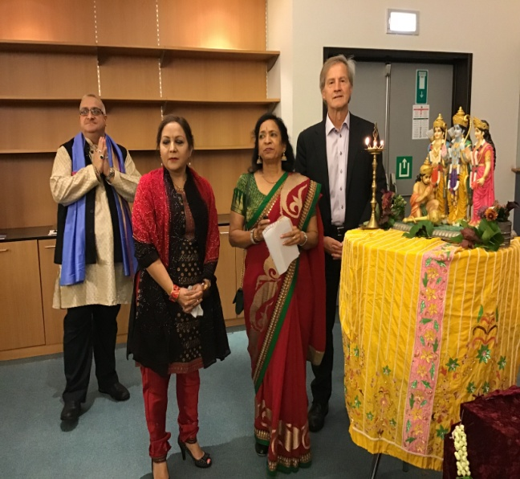
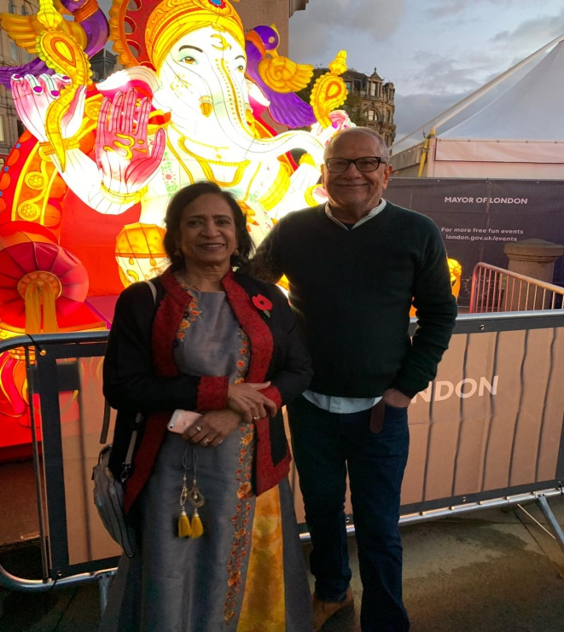
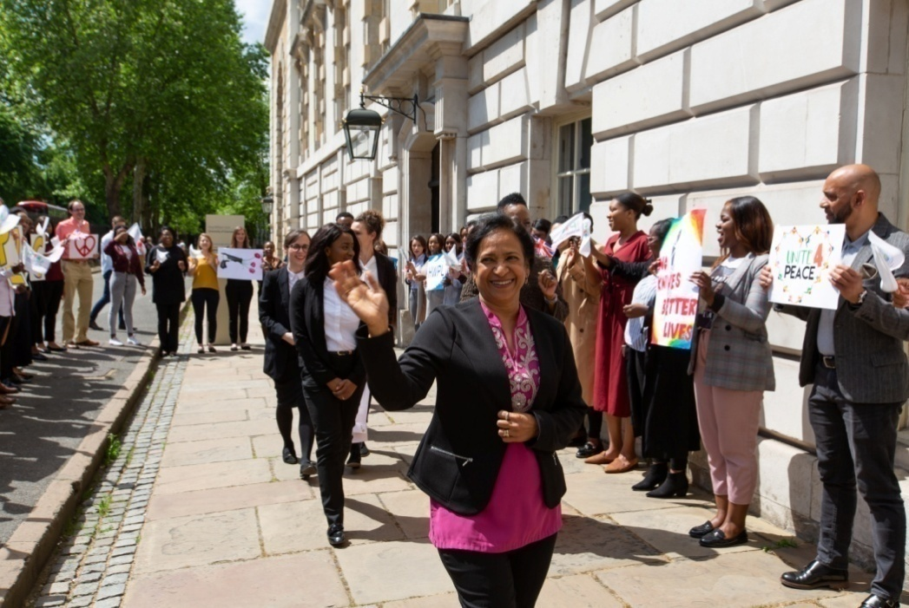

Slide 12

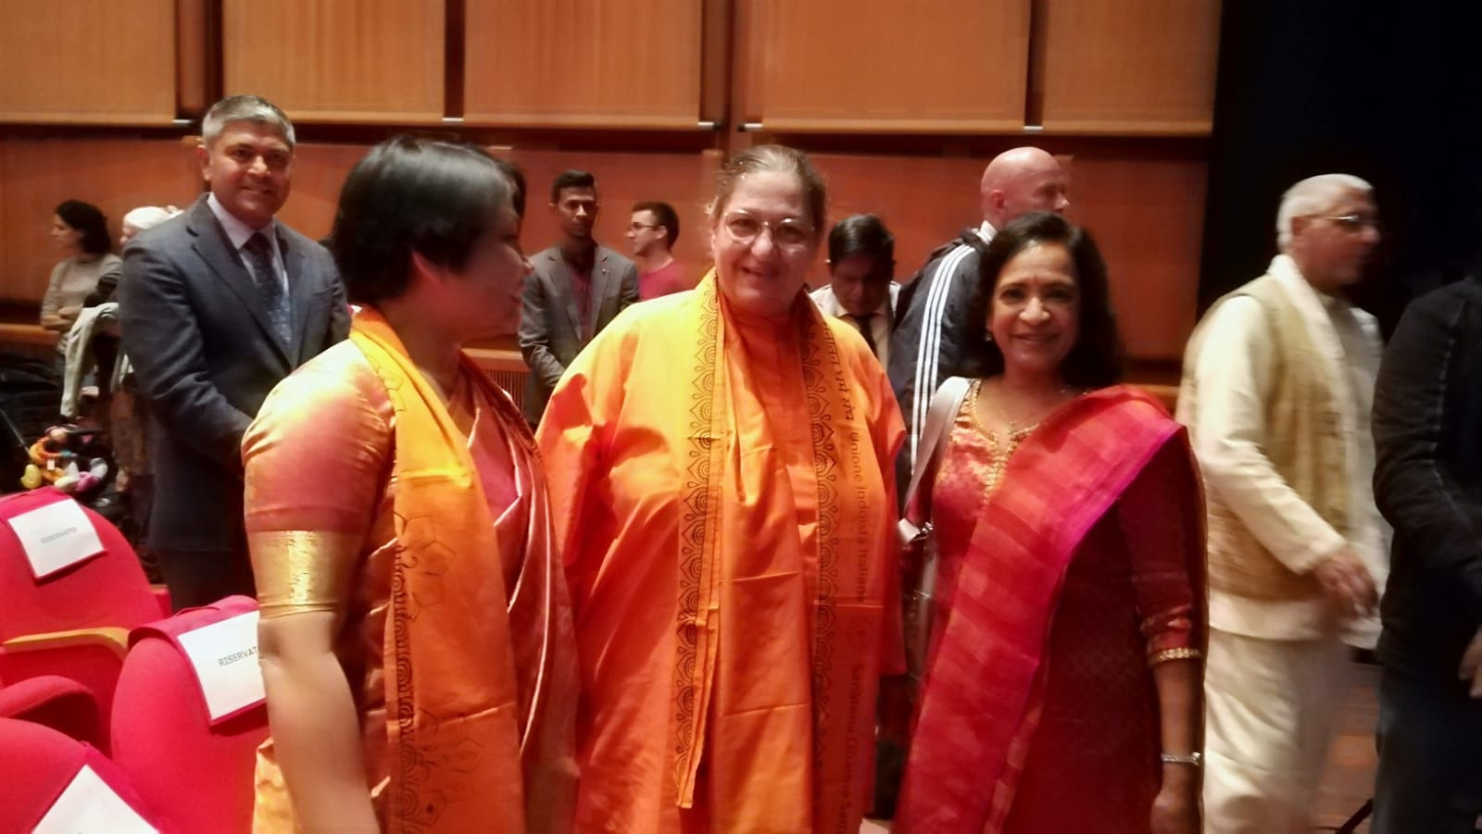

Slide 13
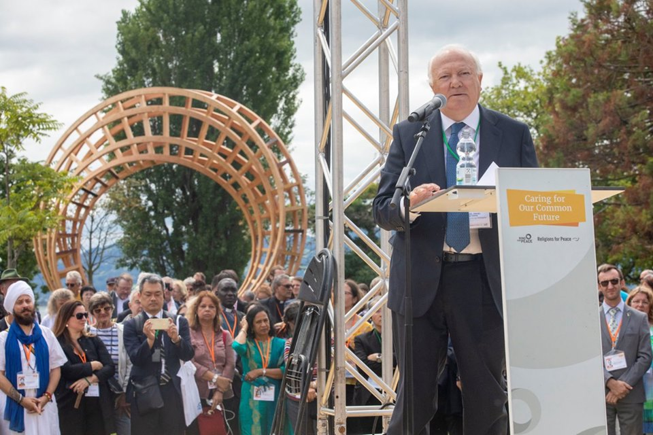

Slide 14
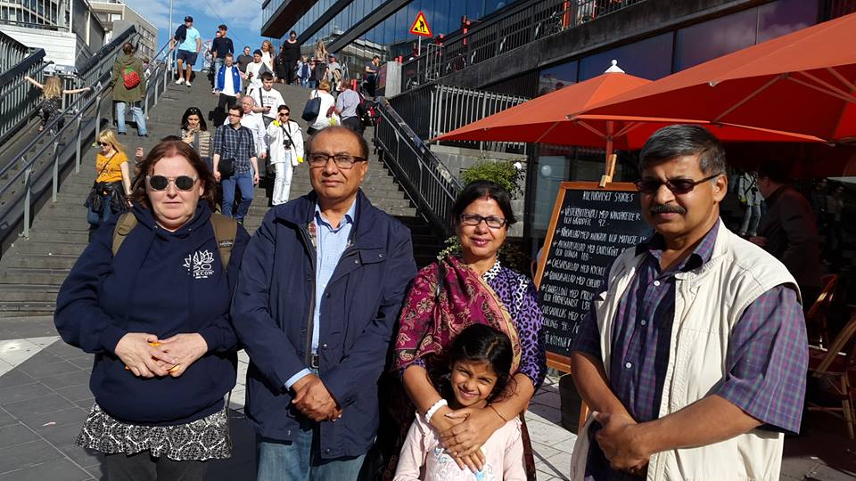
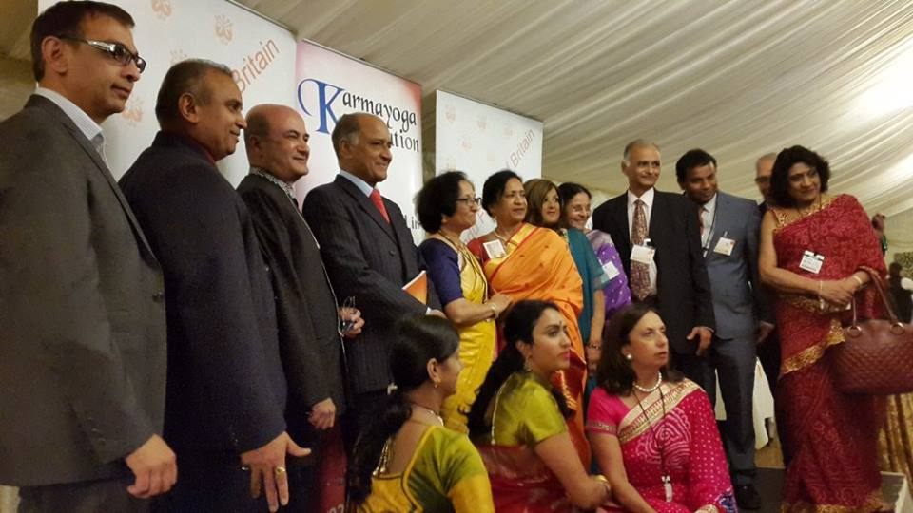
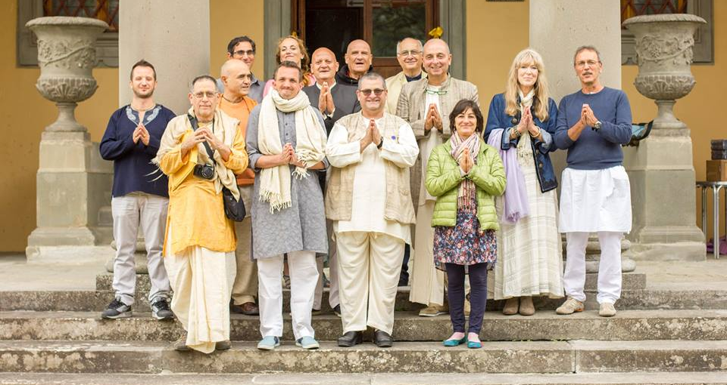
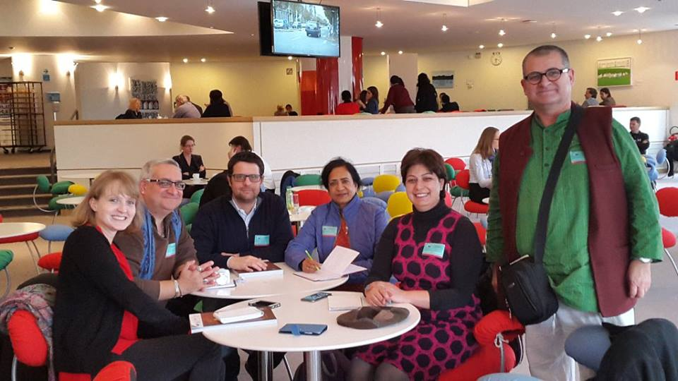

Slide 15
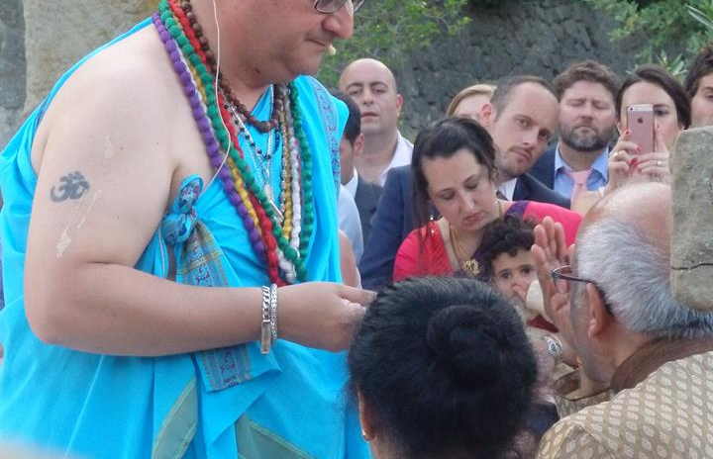
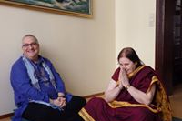
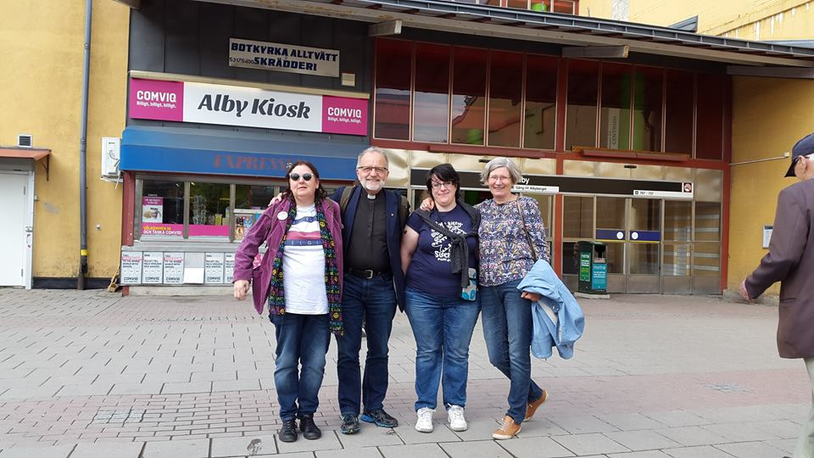

Slide 16
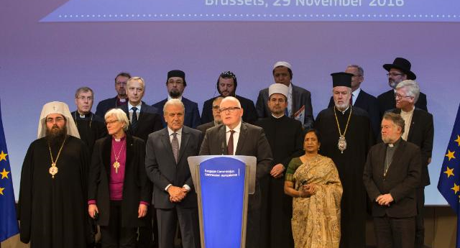
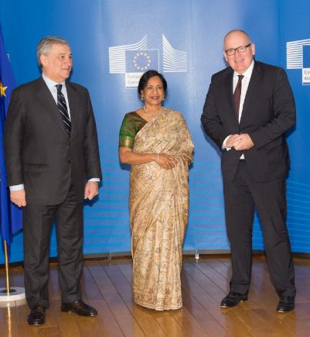
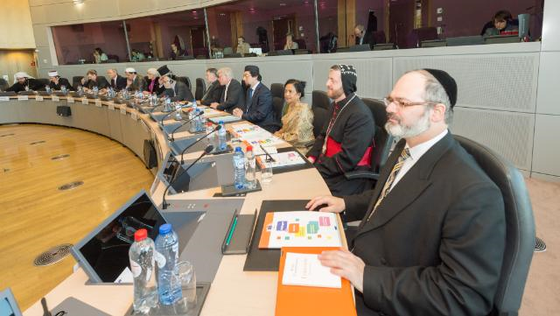

Slide 17
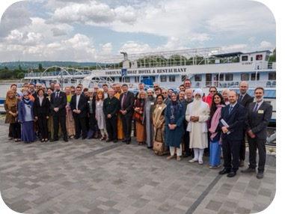
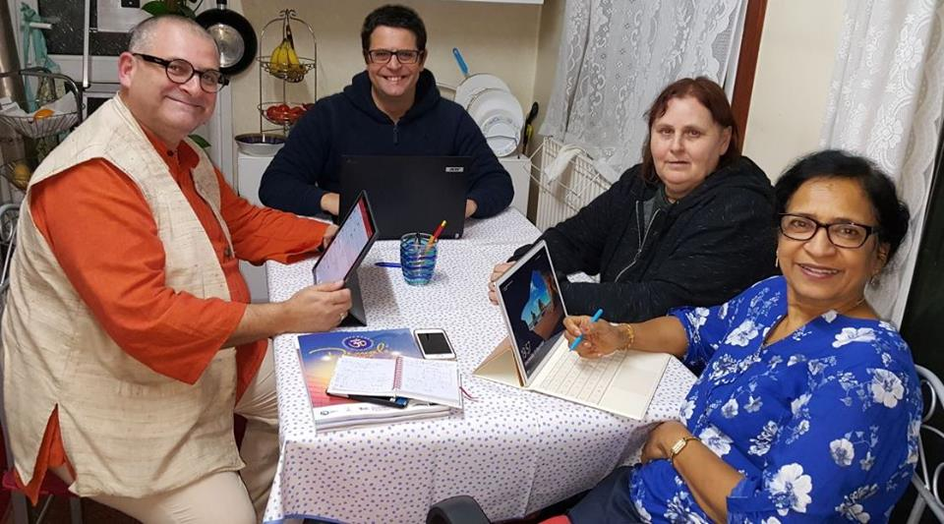

Slide 18
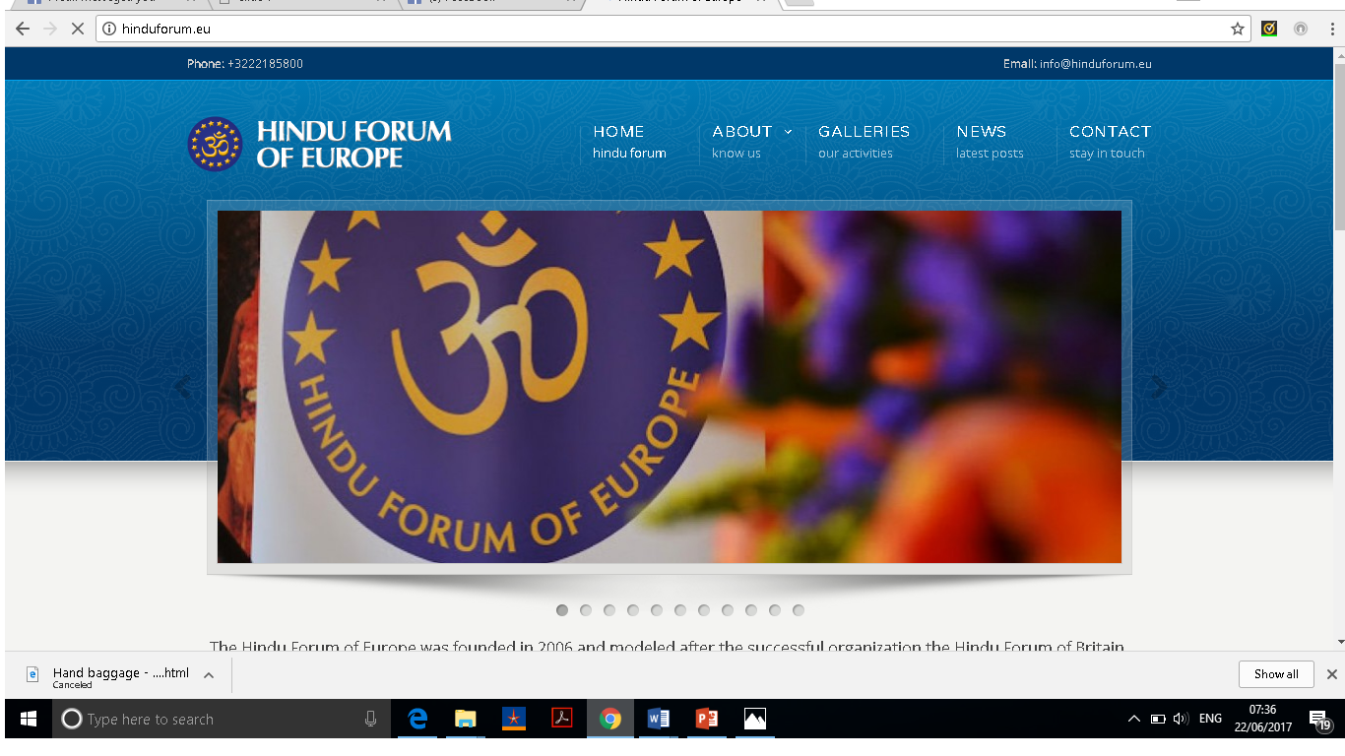
www.hinduforum.eu
Address:
Avenue D’Auderghem 197
1040 Etterbeek
Belgium
Phone/Fax:
+32 22185800
Email:
info@hinduforum.eu

Slide 19
ACHIEVEMENTS
Several countries of Europe are
members of HFE. Sweden, Spain
UK, Belgium, Portugal,Luxembourg,
Hungary, Italy, Isckon Italy, NCHT,
Sanskruti, Hindu Studies in Europe,
Triditional medicine & Scienes
Successfully guided and helping
the member organisations on various local issues
Participated in high level religious
meeting at EU Commission
Dialogues with Vatican City and
Pope’s office, KAICIID, RfP, ENORB,
ECRL, IARF, Berkly centre, and more
Celebrating Diwali in the EU Parliament since 2015
Partnership on India Week 2017 with EU & High commission
Successful awareness programs
Successful Conference at LISBON, PORTUGAL
Successful Representation at ENORB, ECLR, FRA, RfP, European Commission and other interfaith networks
5TH Diwali celebrations in the European Parliament
Liaise with Pakistan, Bangladesh and SE Asian countries on HINDU ATTACKS & atrocities

Slide 20
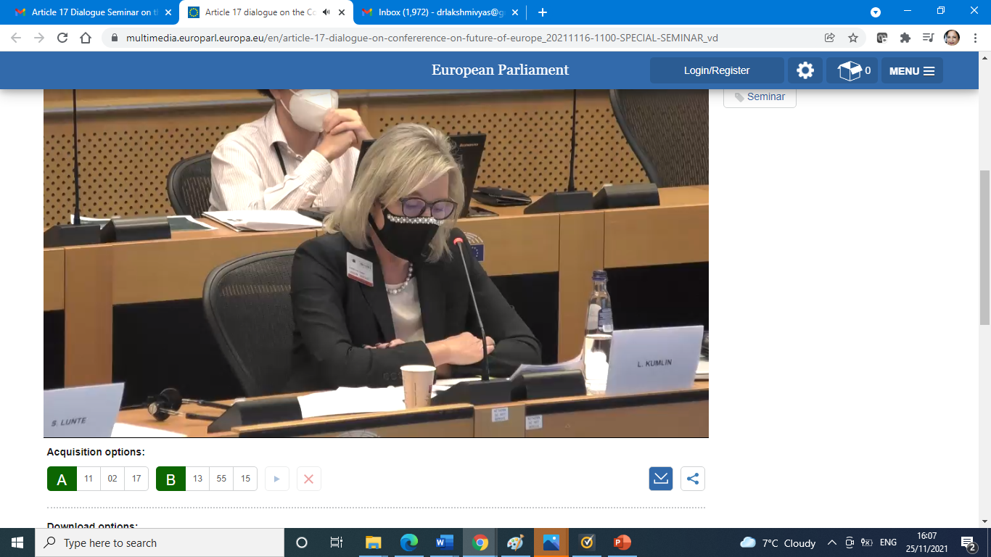

Slide 21
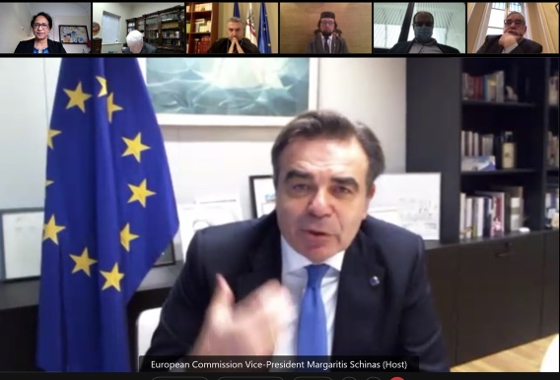

Slide 22
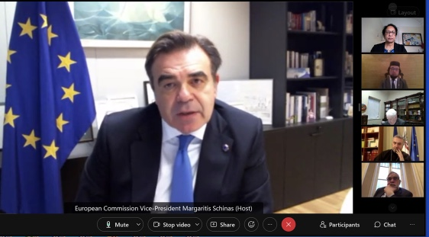
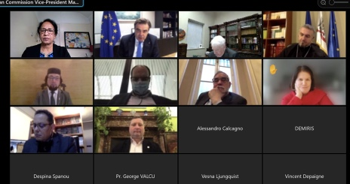

Slide 24
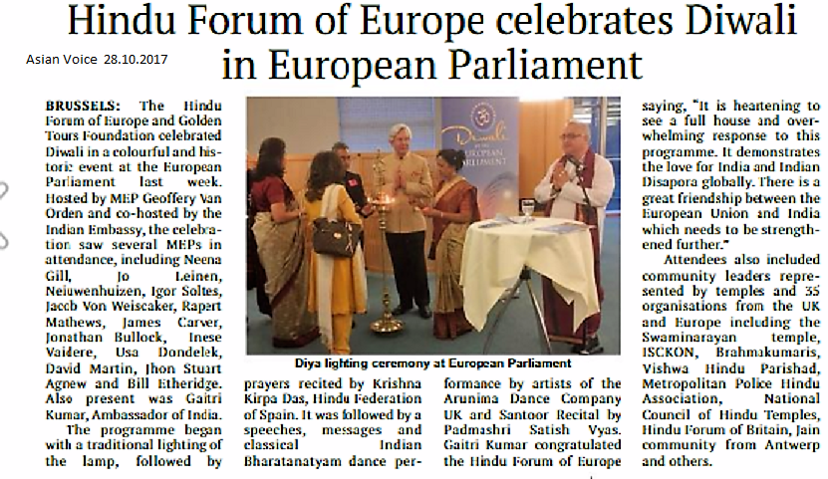

Slide 25
HFE Advisors, Patrons & Spiritual Leaders
Advisers & Spiritual Leaders
Sister Maureen – Brahma Kumaris Europe
Swami Amarananda – Ramakrishna Mission Geneva, Switzerland
Shaunaka Rishi Das – Director of the Oxford Centre, UK
Swami Rameshwaranana Giri
Patrons
Professor Nathu Puri CBE –
ANIL PURI – DIRETON OF PURICO
Palan Foundations -Main sponsor of Diwali
NITIN & KAMU PALAN
Trustees
* DR. LAKSHMI VYAS

Slide 26
Our Members
Confederazione Italiana per Concienza de Krishna
Federacion Hindu de Espana
Hindu Council of Holland
Hindu Forum of Belgium
Hindu Forum of Britain
Hindu Forum Sweden
Hindu Religious Organisation in Austria
ISKCON Hungary (HSKCON)
Unione Induista Italiana
NCHT -National Council of Hindu Temples – UK
Portuguese Yoga Confederation
Swiss Federation of Hinduism
Hindu Matters in Britain
Hindu Forum Luxemburg
Sanskruti
Hindu Studies in Europe
Traditional Mediines and sciences

Slide 27
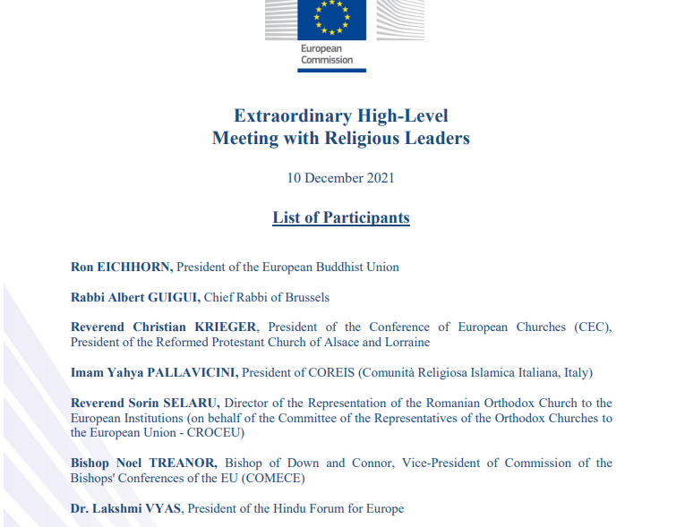

Slide 28
Dialogue with churches, religious associations or communities and philosophical and non-confessional organisations
The dialogue with churches, religious associations or communities and philosophical and non-confessional organisations allows for an open exchange of views between EU institutions and important parts of European society on EU policies. It was established in the beginning of the 1990s by EU Commission President Jacques Delors and offers an opportunity to engage in the European policy making process. Currently the dialogue is under responsibility of Vice President Schinas.
Vincent Depaigne is the Coordinator for the dialogue between the European Commission and churches, religious associations or communities as well as philosophical and non-confessional organisations.
Contribute to the exchange on Twitter: #Art17Dialogue
Contact: JUST-DIALOGUE@ec.europa.eu

Slide 29
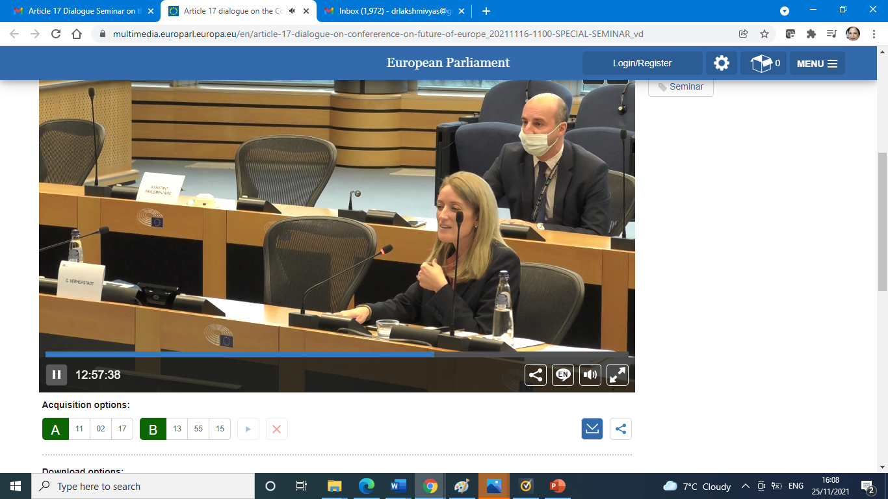

Slide 30
Dear colleagues and partners,
I am writing to you to update you on the developments in the Conference on the Future of Europe.
A number of developments have taken place in November and December:
Release of the 3rd interim report of the Multilingual Digital Platform of the Conference on the Future of Europe as well as a report on the contributions to the Platform per Member States. Both reports are available under:
https://futureu.europa.eu/pages/reporting
The European Citizens' Panel 2 ‘European democracy/values, rights, rule of law, security’ has just released its recommendations. These recommendations are available under: https://futureu.europa.eu/assemblies/citizens-panels/f/299/
The other European Citizens' Panels are pursuing their work and will issue their own recommendations in January and February 2022. You will find relevant information under the following links:
Panel 1: Stronger economy, social justice, jobs/ education, youth, culture, sport/ digital transformation (link: https://futureu.europa.eu/assemblies/citizens-panels/f/298/)
Panel 3: Climate change, environment/health (link: https://futureu.europa.eu/assemblies/citizens-panels/f/300/)
Panel 4: EU in the world/migration (link: https://futureu.europa.eu/assemblies/citizens-panels/f/301/)

Slide 31
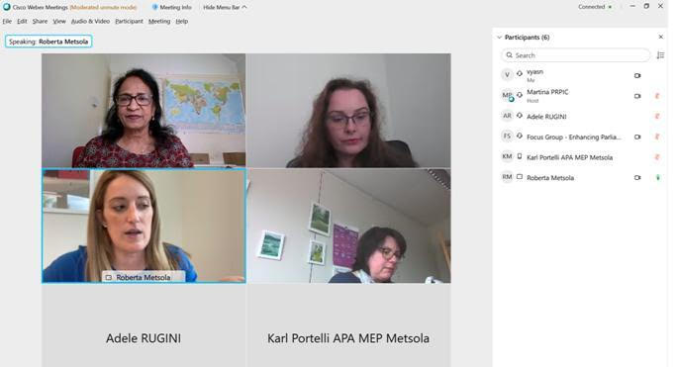

Slide 32

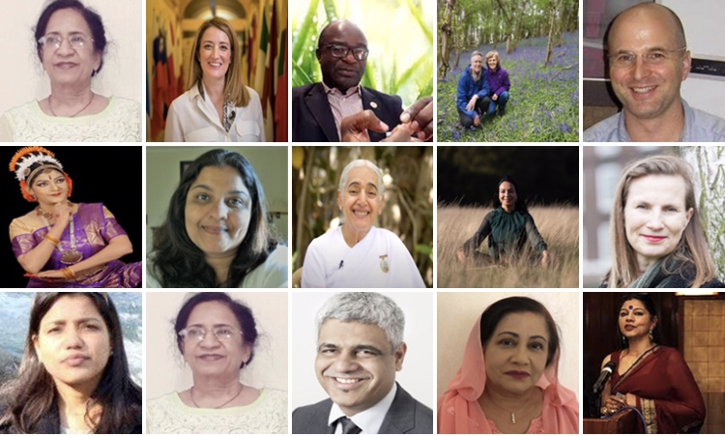

Slide 33
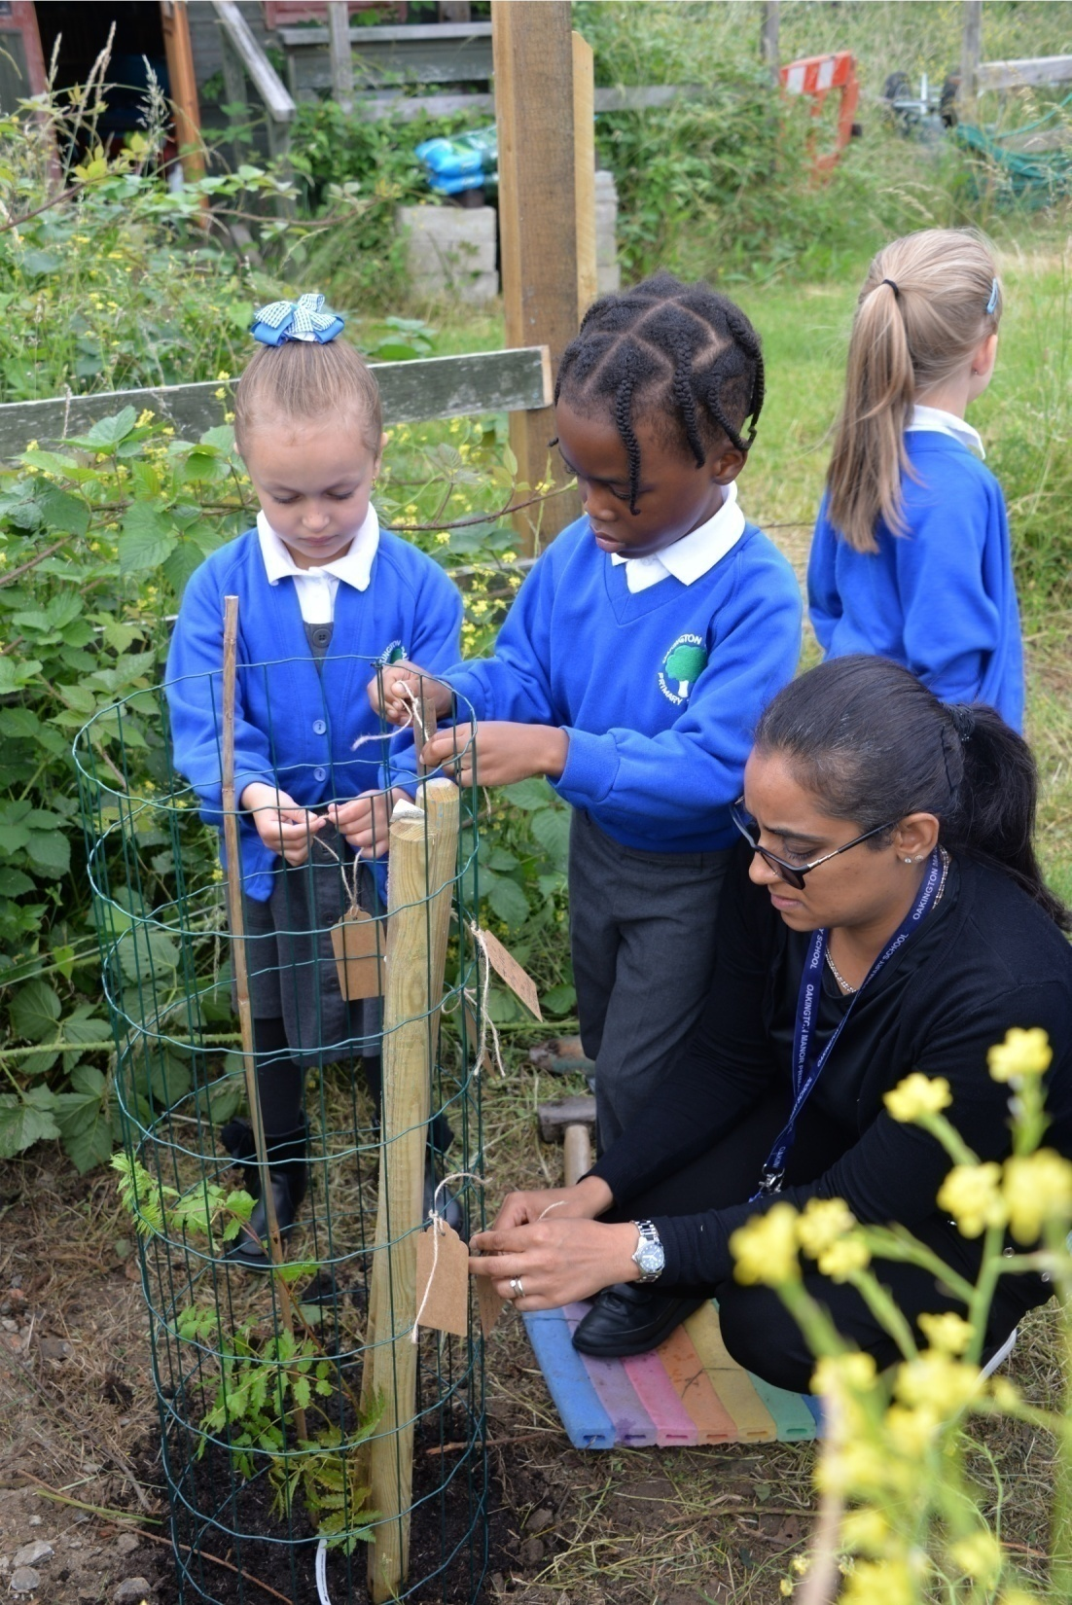
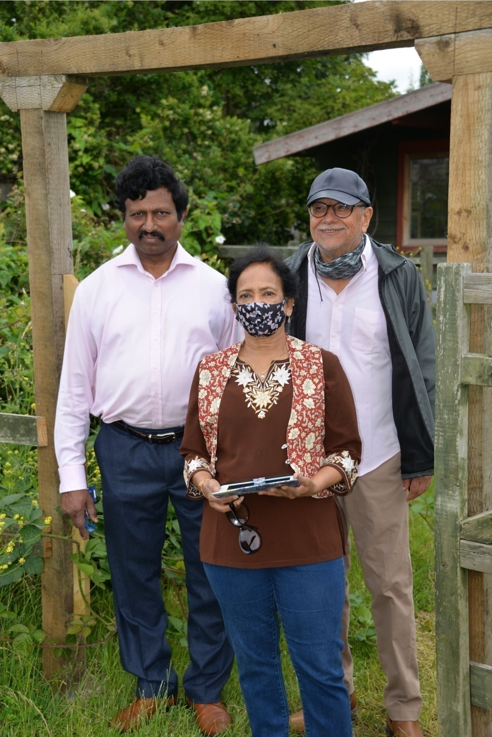

Slide 34
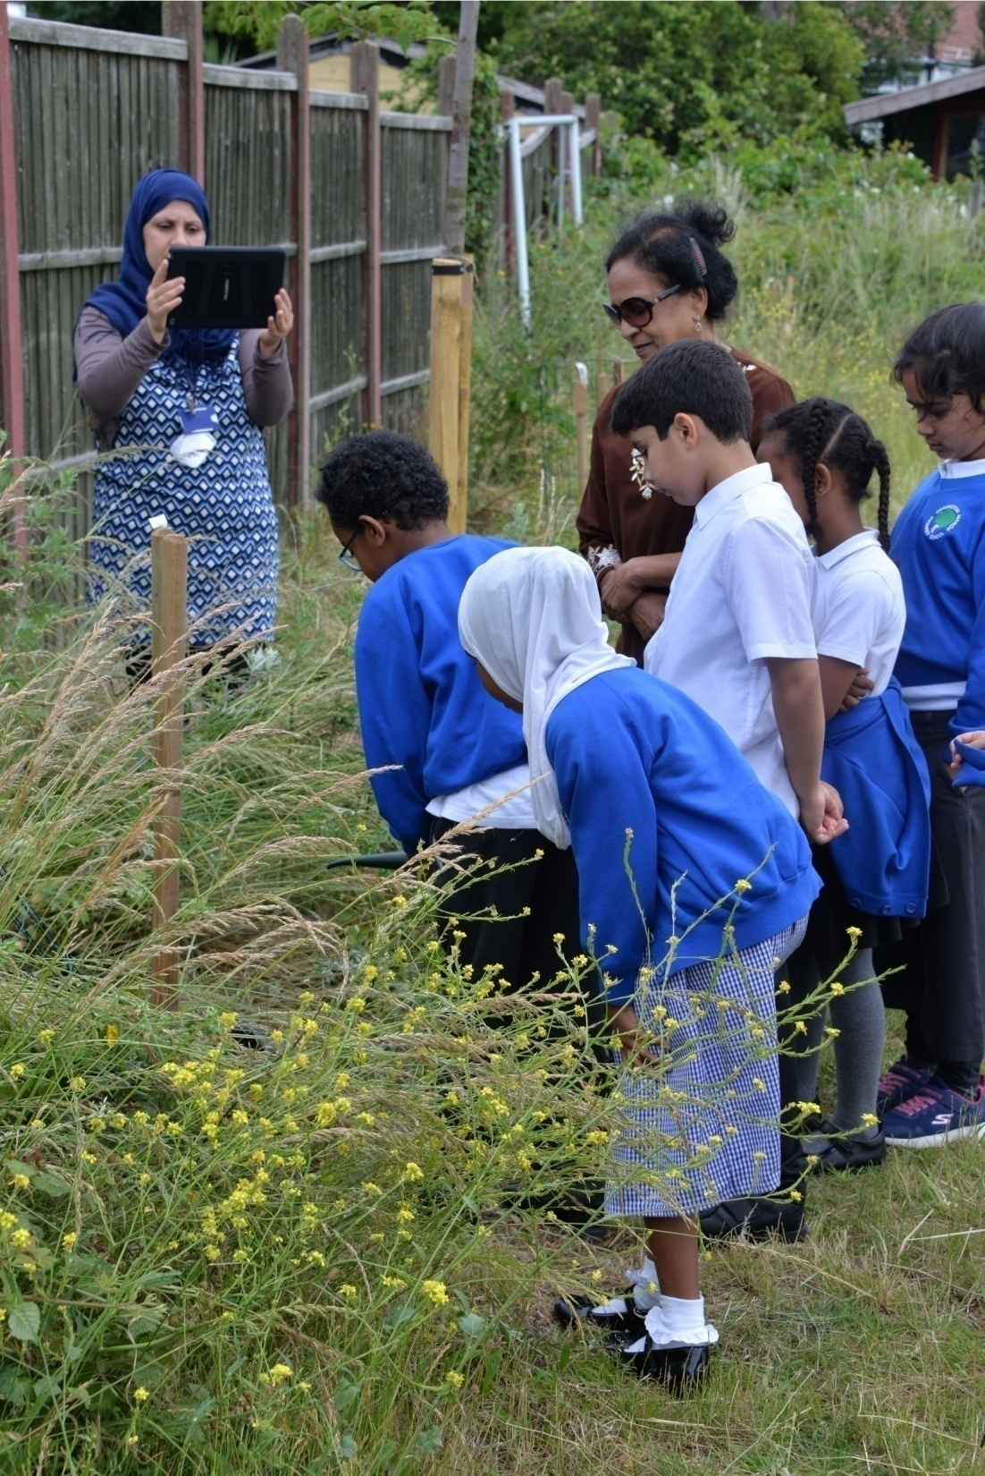
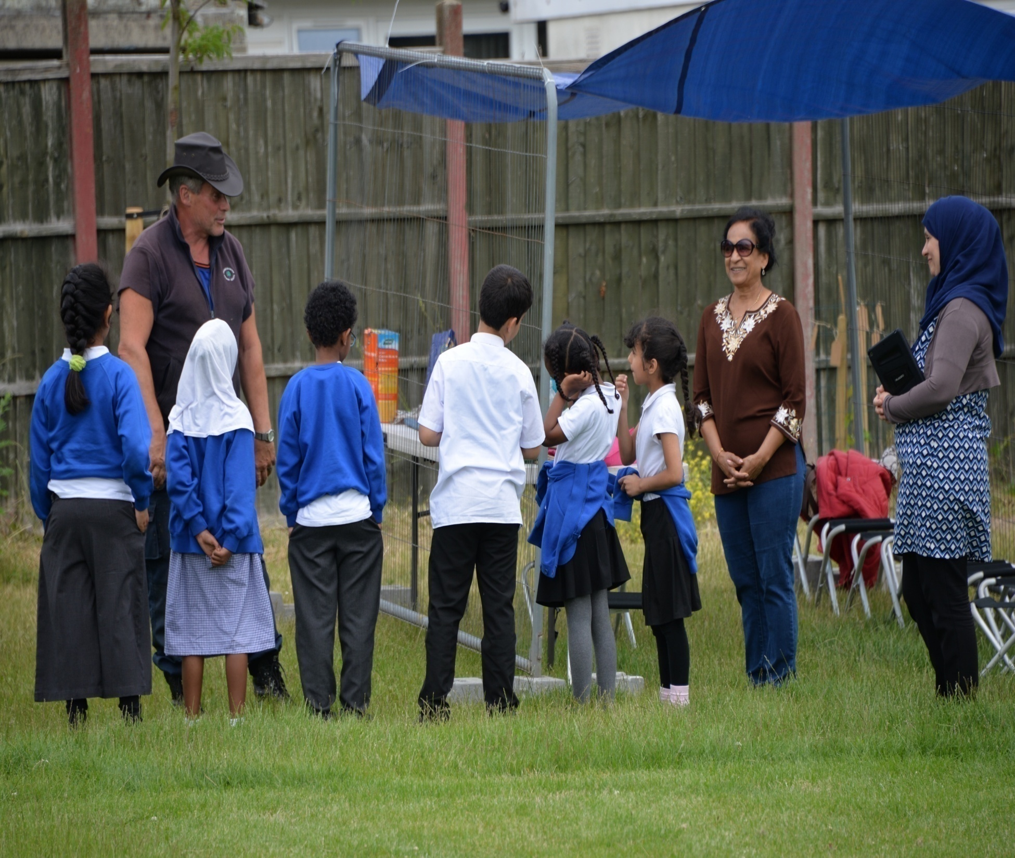

Slide 35
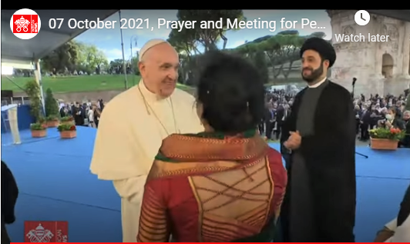
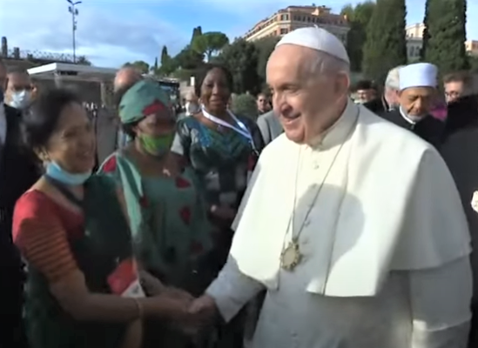

Slide 36
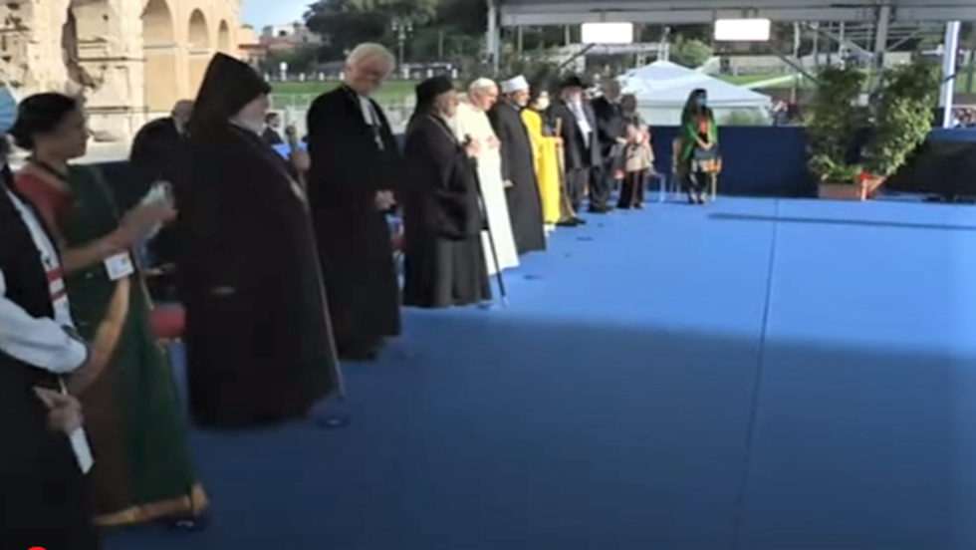

Slide 37
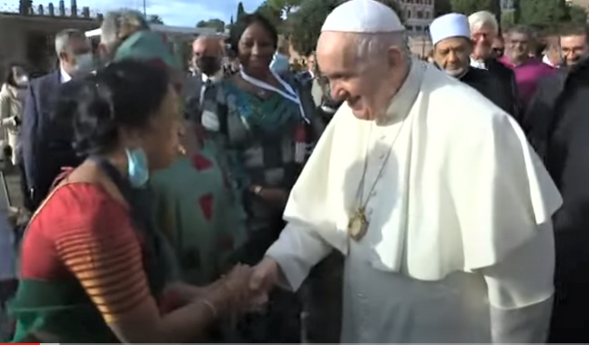

Slide 38
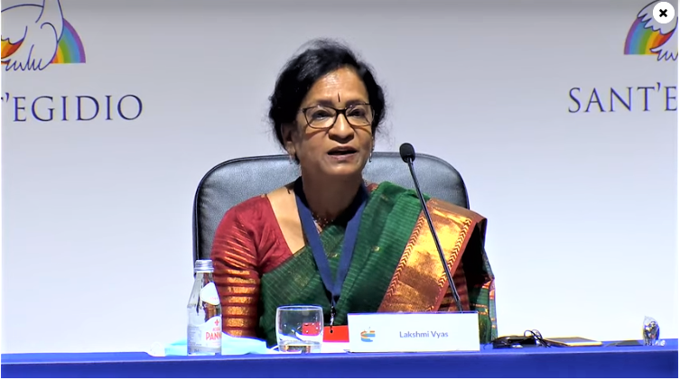
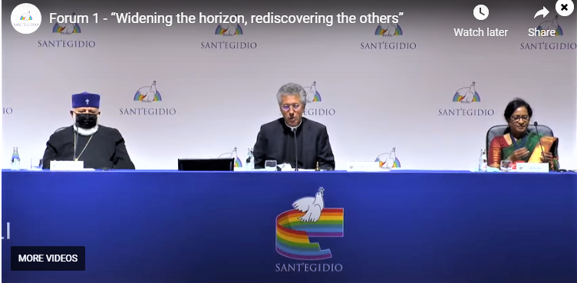
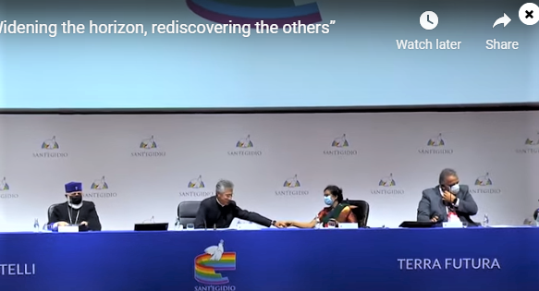

Slide 39

BRIDGING GAPS – MIGRANTS & REFUGEES

Slide 40


Slide 41


Slide 42




Slide 43



Slide 44


Slide 45


Slide 46


Slide 47



Slide 48



Slide 49


Slide 50



Slide 51
Atrocities committed against Hindus in Bangladesh
Hindu organisations from Europe and UK organised peaceful demonstrations and protest in front of the Bangla Desh Embassy in UK, Sweden, Belgium and Spain.
Hindu Forum Europe and Belgium wrote letter to PM Hasina Shaikh and handed it over to Bangla- Desh Embassy at Belgium.
Sweden which has a good amount Bangla Deshis, was also well represented by Hindu Forum Sweden.

Slide 52


Slide 53



Slide 54


Slide 57
1 | 23rdMarch | Amarananda Swami & Krishna Kripaji | Switzerland & Spain
2 | 30thMarch | Meeta Joshi and Lakshmi Vyas | UK
3 | 6TH April | Rameshwarananda & Ragasudha | Spain & UK
4 | 13th April | Mandakini Spennare & Gianluca | Sweden & Italy
5 | 20th April | Madhupathy Das & Parabhakthi Das | Hungary & Italy
6 | 27th April | Ragasudha & Lakshmi Vyas | UK
7 | 4th May | Madhu Shastri & Meeta Joshi | UK
8 | 11th May | Amarananda Swami Solo | Switzerland
9 | 18th May | Arun Jogani & Anjani Ladia | Belgium & Luxembourg
10 | 25th May | Krihnangi & Kavya Rapatwas | Germany & UK Children special
11 | 1st June | Mayura Patel & Sharda Nandram | UK & Netherland
12 | 8th June | Meeta Joshi & Sudha Mandavia | UK
13 | 15th June | Amarananda Swami & Mandakini | Switzerland & Sweden
14 | 22nd June | Rameshwarananda Giri & Ragasudha | Spain & UK
15 | 29TH June | Meeta Joshi & Dr. Bhagya | UK
16 | 7TH July | Lakshmi Vyas & Gianluca | UK & Italy
17 | 13th | Lakshmi & Swami Rameshwarananda | SPAIN
18 | 7th September | Rameshwarananda & Sridhar & Krishnagi | Spain & Germany
19 | 14th Sept | Bhagya Raj & Ragasudha | UK
20 | 21st Sept | Swami ji & Anjana Shekat | Swiss & UK
21 | 28th Sept | Krishna Kripa & Ambi ji | Spain & Luxembourg
22 | 5th October | Maite & Mari Mandakini | Spain & Sweden
23 | 12th October | Ragasudha & Meeta Joshi | UK
24 | 19th October | Meeta Joshi & Ragasudha | UK
25 | 26th October | Swami Amarananda & Meeta Joshi | Swiss and UK
26 | 2nd November | Diwali special | All present
27 | 9th November | Diwali cum New year special | All present
28 | 16th Novemer | Laabh Pancchami | All present
29 | 23rd November | Tulasi vivah speccial | All present

Slide 58
So let's wait if they quit on their own.
Membership: | Payment due
Isckon Italy : | 2020, 2021
Union Italiana: 2019, 2020m 2021 | 2019, 2020, 2021
Portuguese Yoga: | 2019, 2020, 2021
Hindu Matters in Britain; | 2019, 2020, 2021
NCHT: | 2018, 2019, 2020, 2021
Hindu forurm Netherland: From 2012 till date | 2012, 13, 14, 15, 16, 17, 18. 19. 20, 21 - ten years
Hindu forum Belgium: | 2019, 2020, 2021
Luxembourg: | 2019, 2020, 2021
Hindu forum Spain: | 2020, 2021
Isckon Hungary : | 2019, 2020, 2021
Hindu forum Britiain : | 2017, 2018, 2019, 2020, 2021 (5 yrs)
Hindu Forum Sweden | Uptodate
Hindu Forum Switzerland | 2019, 2020, 2021

Slide 59


